Slide 1
What is Asexuality?
An Orientation to an Orientation

Slide 2
What is Asexuality?
Asexuality is a sexual orientation characterized by a persistent lack of sexual attraction toward any gender.
At least 1% of people are believed to be asexual.

Slide 3
Who Is Asexual?
An asexual person can be any:
Sex
Gender
Age
Ethnic Background
Body Type
Economic Status
Religion
Political Affiliation
In short: There is no asexual “type”.

Slide 4
A Misunderstood Orientation
Asexuality is not an abstinence pledge.
(Although there may be abstinent or celibate aces.)
Asexuality is not a gender identity.
(Although there may be trans, non-binary, or genderqueer aces.)
Asexuality is not a disorder.
(Although there may be aces with physical or mental conditions.)
Asexuality is not a choice.
(Although not every ace is “born that way”.)
Asexuality is not a hormone imbalance.
(Although there may be aces with hormone issues.)

Slide 5
Attraction, Not Action
Asexuality is about what someone feels, not what someone does.
It is possible for an asexual person to date, fall in love, masturbate, have sex, or have children and still be asexual.

Slide 6
Some Do, Some Don’t
Do asexuals date?
Do asexuals fall in love?
Do asexuals have sex?
Do asexuals masturbate?
Do asexuals get married?
Do asexuals like pepperoni pizza?
Some do. Some don’t.
(Pretty much any question that starts with “Do asexuals …?” can be answered this way.)

Slide 7
The Gray Areas
Gray-Asexuality: In between asexuality and non-asexuality, such as experiencing sexual attraction infrequently, being unsure if one has experienced sexual attraction, or otherwise feeling that one does not quite fit the definition of asexuality.
Demisexuality: Only experiencing sexual attraction after close emotion bond is formed.
Asexual Spectrum: The spectrum of sexuality which includes asexuality, gray-asexuality, and demisexuality.

Slide 8
The Concept of Love
Romantic orientation describes the genders someone is romantically attracted to.
Heteroromantic: Different gender
Homoromantic: Same gender
Bi or Panromantic: Multiple genders
Aromantic: No genders
(And so on.)
Romantic and sexual orientation are often aligned, but do not have to be. Any combination is possible.

Slide 9
How Can I Tell?
If you think you might be asexual, ask yourself these questions:
Have I never (or very rarely) experienced sexual attraction?
Am I generally disinterested in sex?
Is my interest in sex more scientific than emotional?
Was my experience of having sex closer to “meh” than fireworks and supernovas?
Do I feel left out or confused when others discuss sex?
Have I ever had to pretend to be interested in someone in order to “fit in”?
Have I ever felt “broken” because I don’t experience sexual feelings like those around me?
Have I ever felt that I was straight “by default” or bi/pan because I was equally (dis)interested in all genders?
Have I ever gone out with someone or had sex because “That’s what I’m supposed to do”?
While this isn’t a diagnostic checklist, if you answered “yes” to one or more of these questions, you may want to learn more about asexuality to see if it fits you.

Slide 10
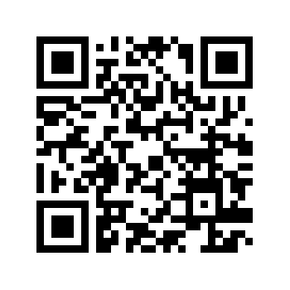
More Information
http://www.whatisasexuality.com/intro/

Slide 11
Produced By

